Slide 1
File Management
1.5 File Management

Slide 2
We are going to learn
We are going to learn:
The difference between a file and a folder.
The difference between “save” and “save as.”
To recognize file types by their icons.

Slide 3
We are going to learn
We are going to learn:
How to create a folder
How to change file and folder names.
How to copy, cut and paste files and folders.
How to drag and drop files and folders.

Slide 4
We are going to learn
We are going to learn:
The difference between cut and copy.
How to make changes to a file and save the changes.
The importance of keeping your files organized.

Slide 5
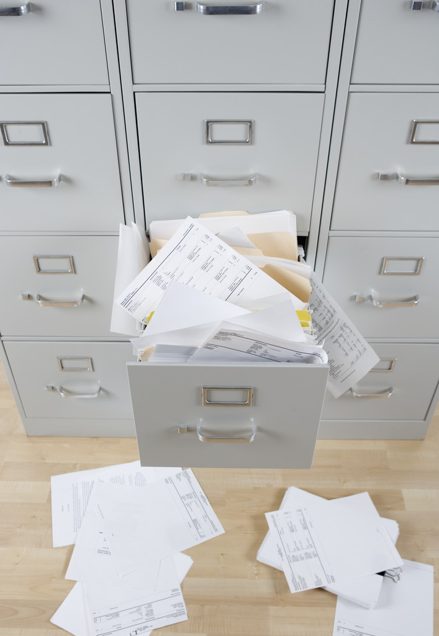
File Management Matters
File
Management
MATTERS!

Slide 6
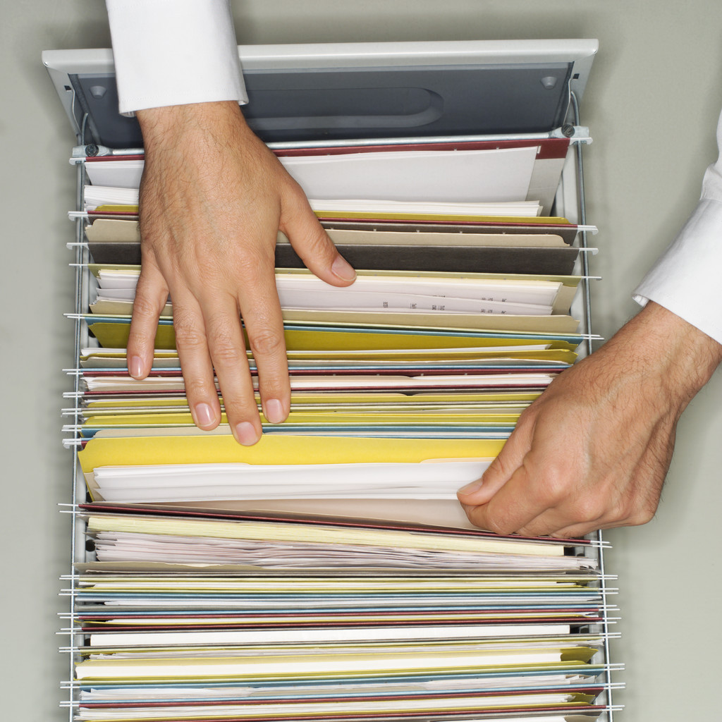
File Management Matters
File
Management
MATTERS!

Slide 7
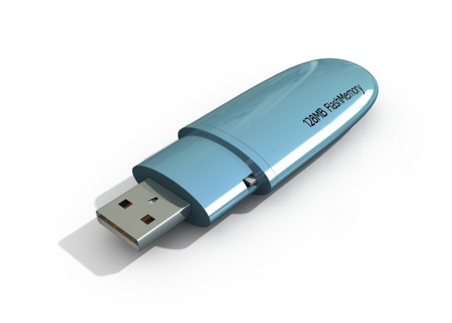
File Management
File Management
Between primary and secondary storage capabilities, your computer has the ability to store and retrieve VAST amounts of data!

Slide 8
File Management
File Management
However, if your files are not organized, in a way that makes sense to you, retrieving files could end up being a difficult task indeed.

Slide 9
My Documents
My Documents
One of the default locations in which the computer saves your files is called “My Documents.” This can be located on your computer’s hard drive and/or on a server on your network.

Slide 10
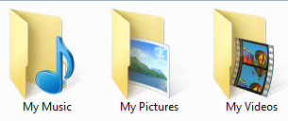
My Documents
My Documents
If you don’t “tell” the computer to do otherwise, it will save your:
music files to the My Music folder
pictures to the My Pictures folder
videos to the My Video folders.

Slide 11
My Files
My Files
You have a USB drive with all of your work files on it. You have over 1000 files!
Can you imagine sorting through that many files?

Slide 12
How to manage files
How to Manage Files
Organizing files and saving them to a computer or external storage device is very similar to how we used to set up filing systems in a filing cabinet.

Slide 13
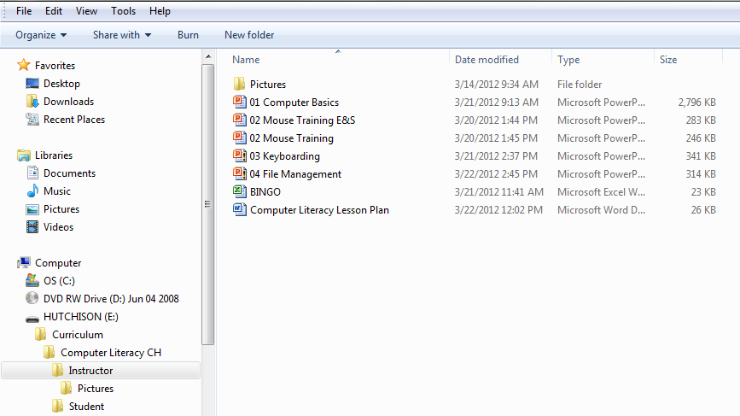
File Icons
Notice the different icons for these files.
What kind of file type goes with each icon?

Slide 14
Time to practice
Time To Practice!

Slide 15
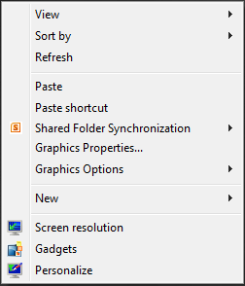
Popup Menu
Right Mouse Click on any empty space on your desktop to get this pop up menu.

Slide 16
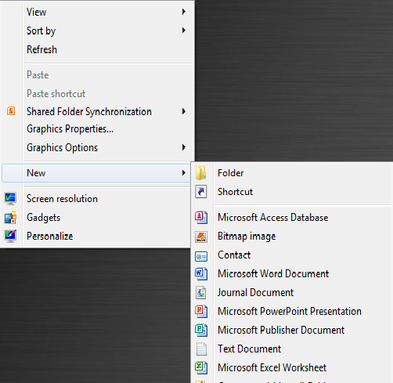
Sidebar Menu
Click the New option to get the side bar menu pictured at the right.

Slide 17
Folder Option
Click the Folder Option.

Slide 18
Naming the folder
A new yellow folder will appear on your desktop.
Type your name in place of the words new folder.
Connie is our example student.

Slide 19
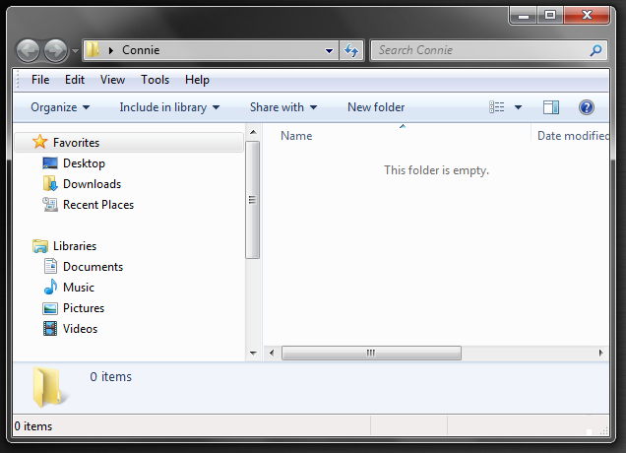
Sizing folder windows
Double Click
the folder with
your name on
it to open it. It is empty.
Click on the edge of the window with your mouse and drag to resize the window so it is smaller.

Slide 20
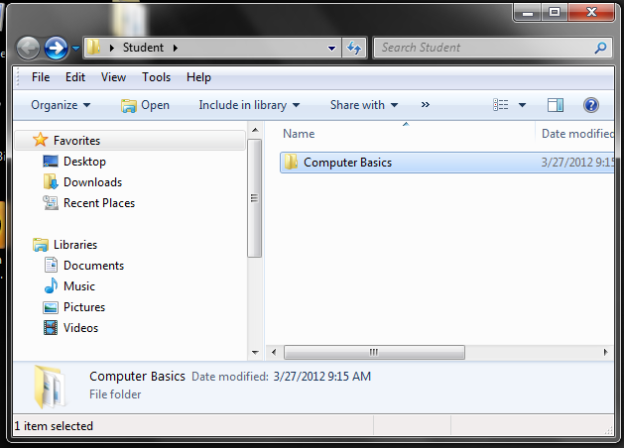
Computer basics folder
Double Click on the Student Folder.
Notice the Computer Basics Folder inside the Student Folder.

Slide 21
Resizing folders
Resize your 2 folder windows so you can see both at the same time.

Slide 22
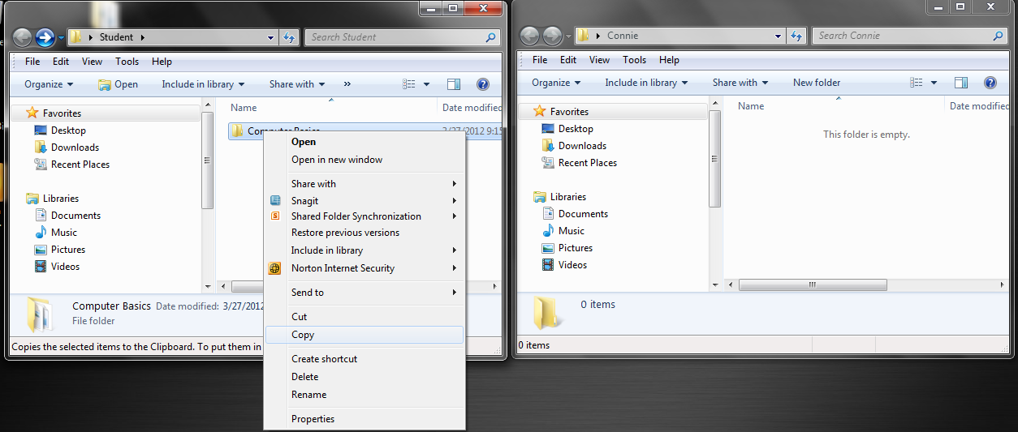
Right click
Right Mouse Click on the Computer Basics folder in the Student Folder and click the copy option.

Slide 23
Right click and paste
Now Right Mouse Click in the blank area in the folder with your name and click the paste option.

Slide 24
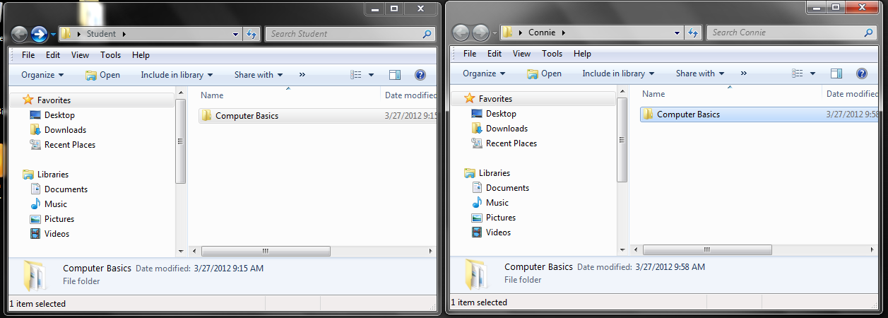
Copying folder content
An exact copy of the student folder will appear in the folder with your name.

Slide 25
Close a folder
Close the student folder by clicking the X at the upper right hand corner of its window.

Slide 26
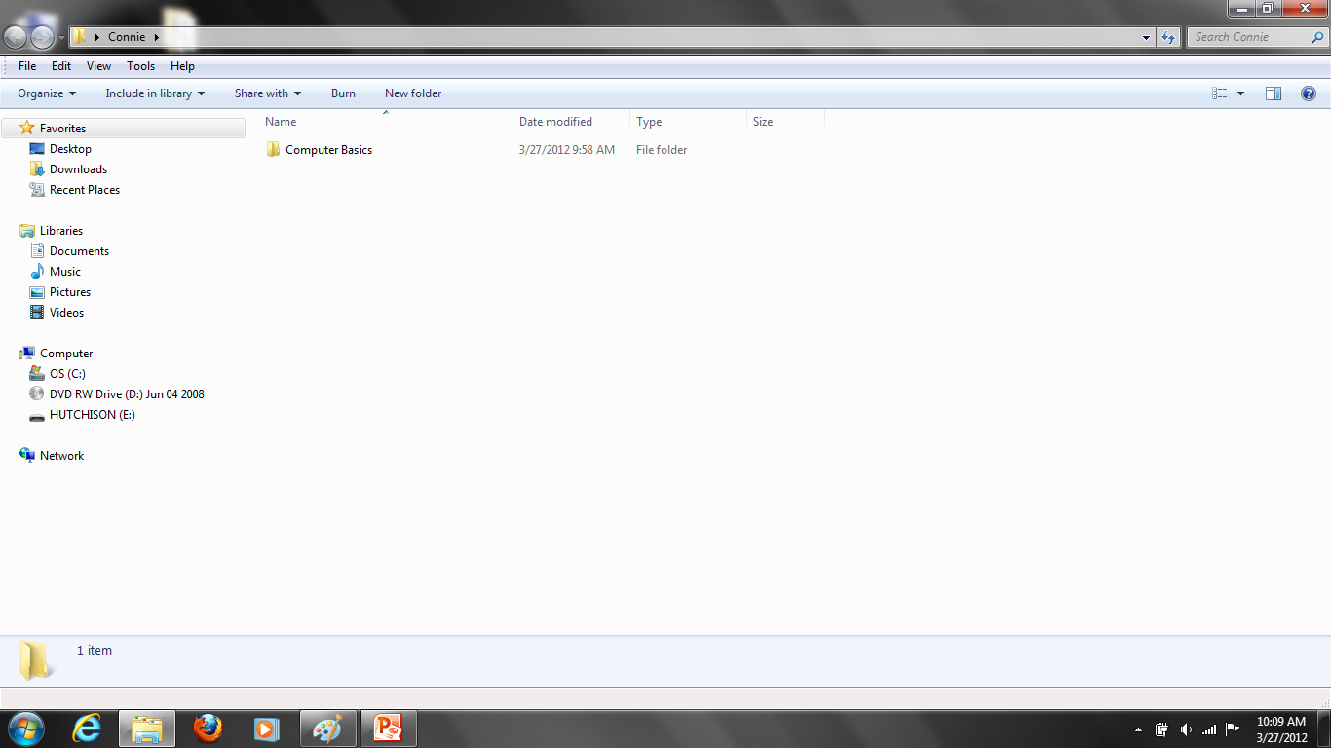
Maximizing folders
Maximize YOUR folder to fill the screen by clicking the restore/maximize button at the top right hand corner of its window.

Slide 27
Subfolder
Create another new folder (subfolder because it is inside another folder) and name it Practice.

Slide 28
Restoring the folder window
Restore this folder to its previous size by clicking the restore/maximize button at the top right hand corner of the screen again.

Slide 29
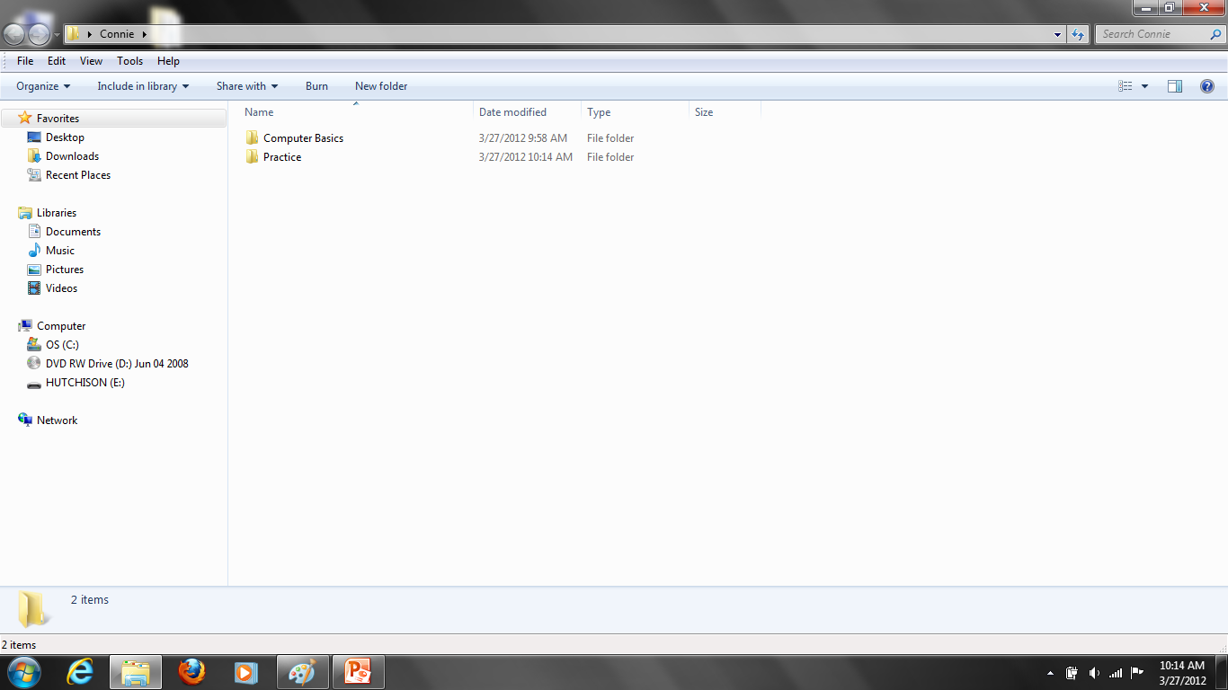
Opening a folder
Double Click on the Computer Basics folder to open it.

Slide 30
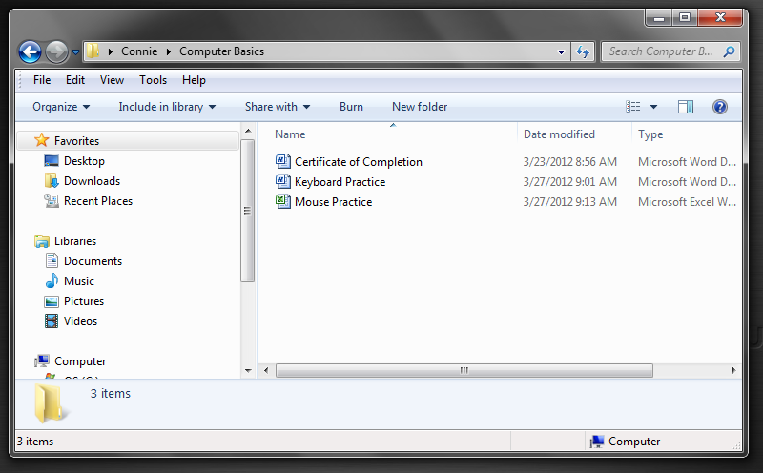
Icons
Notice the different icons.

Slide 31
Shift Key
Click one time on the first file and hold down the shift key while clicking on the last file.

Slide 32
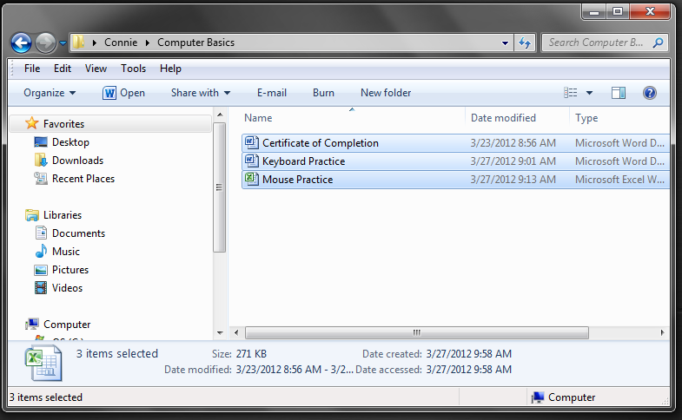
Copying multiple files
The three files are now selected.
BE CAREFUL!!!
Right mouse click on any of the files and click copy.

Slide 33
Closing a folder
Close this folder.

Slide 34
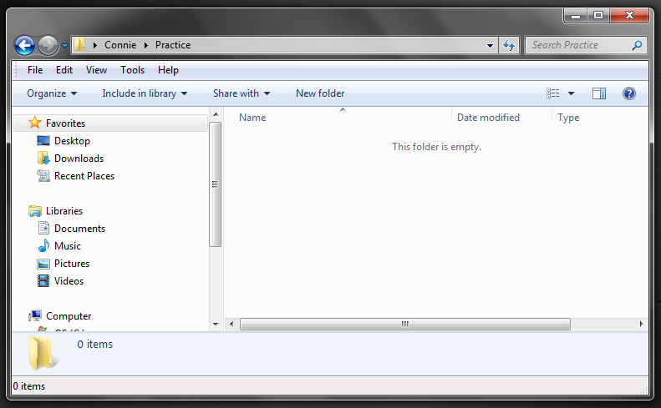
Opening folders
Double Click on the folder with your name on it to open it.
Then open the practice folder.

Slide 35
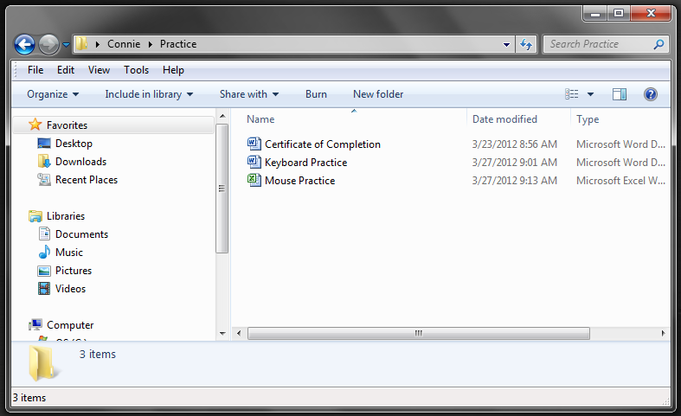
Right mouse click and paste
Right mouse click in the blank space and click the paste option.
You now have a copy of each file in each folder.

Slide 36
Cut and paste options
You can also cut and paste files between files using the right mouse click method
OR
by using the Ctrl X to cut and Ctrl V to paste method you learned in the keyboarding practice document.

Slide 37
Practice session details
This practice session was done using existing files.
Even though you can move files from one folder to another, it is IMPORTANT that you know how to save a file to the correct location when you create it!

Slide 38
File management practice demo
File Management Practice
DEMONSTRATION

Slide 39
File management practice instructions
File Management Practice
Follow your handout and what I am doing to complete this practice.
You will start by opening Microsoft Word on your computer.

Slide 40
File management practice step by step
File Management Practice
Click the start button at the bottom left hand corner of your desktop.
Click on “All Programs.”
Use your mouse to scroll or the arrow keys to choose “Microsoft Office.”
Then click “Microsoft Word.”

